Slide 1
Control Engineering
Lecture 11

Slide 2
Optimum control systems
A performance index is a quantitative measure of the performance of a system and is chosen so that emphasis is given to the important system specifications.
A system is considered an optimum control system when the system parameters are adjusted so that the index reaches an extremum value, commonly a minimum value.

Slide 3
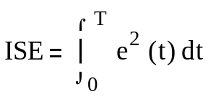
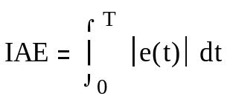
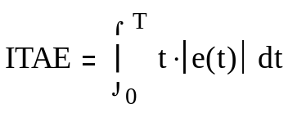
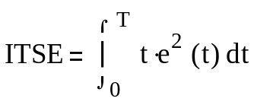
Performance Indices
There are several performance indices:
Integral of the square of the error, ISE
Integral of the absolute magnitude of the error, IAE
Integral of time multiplied by absolute error, ITAE
Integral of time multiplied by the squared error, ITSE

Slide 4

Example 1
Consider a 4th-order system:
Compare closed-loop performance of PID controllers designed with different performance indices.
G=zpk([],[-3 -2 -1 0],1); % The plant C1=optimPID(G,3,1); % PID-Control, ISE index C2=optimPID(G,3,2); % PID-Control, IAE index C3=optimPID(G,3,3); % PID-Control, ITSE index C4=optimPID(G,3,4); % PID-Control, ITAE index

Slide 5
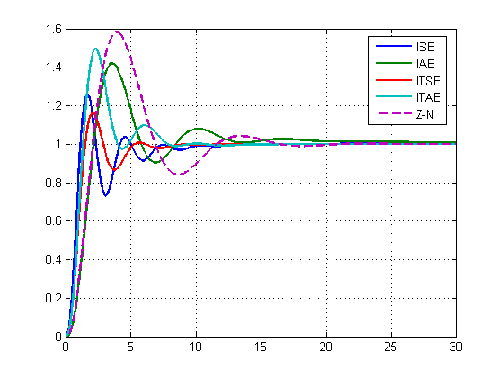
Example 1

Slide 6

Example 2
For a 4th-order system with a repeated pole:
Compare closed-loop performance of PID controllers designed with different performance indices.
G=tf(1,[1 4 6 4 1]); % The plant C1=optimPID(G,2,1); % PID-Control, ISE index C2=optimPID(G,2,2); % PID-Control, IAE index C3=optimPID(G,2,3); % PID-Control, ITSE index C4=optimPID(G,2,4); % PID-Control, ITAE index

Slide 7
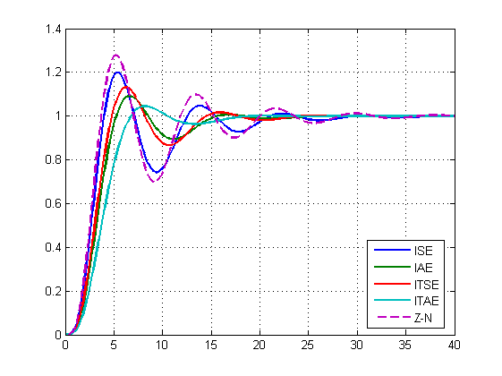
Example 2

Slide 8


Analytical solution
The calculation of ISE index is based on Parseval’s theorem
where E(s) is the Laplace transform of e(t)

Slide 9
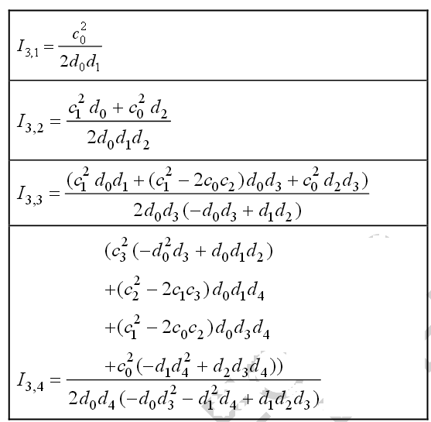
Analytical solution

